Slide 1

OCN 479-001
Sensor communications
(Wireless edition)

Slide 2
Check in…
How are we all doing?
Class pace/challenge balance?

Slide 3
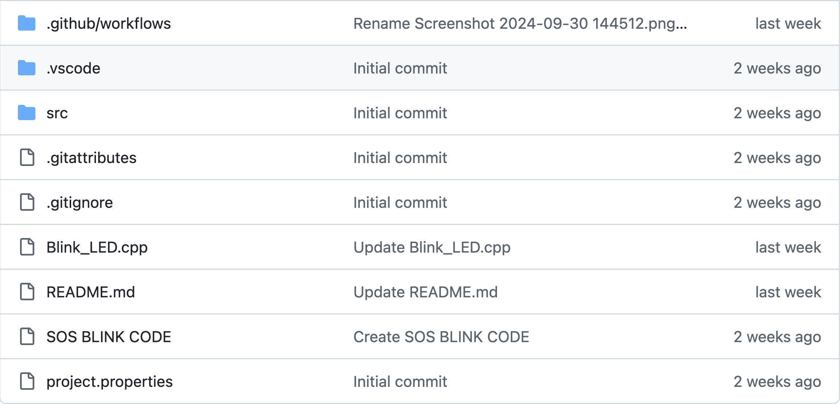
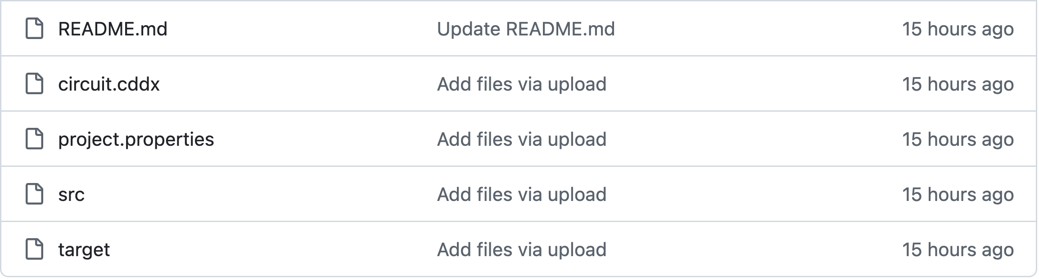
GitHub common issues

Slide 4
Today’s plan
Short group activity/lecture
Student presentations
Build sensors!

Slide 5
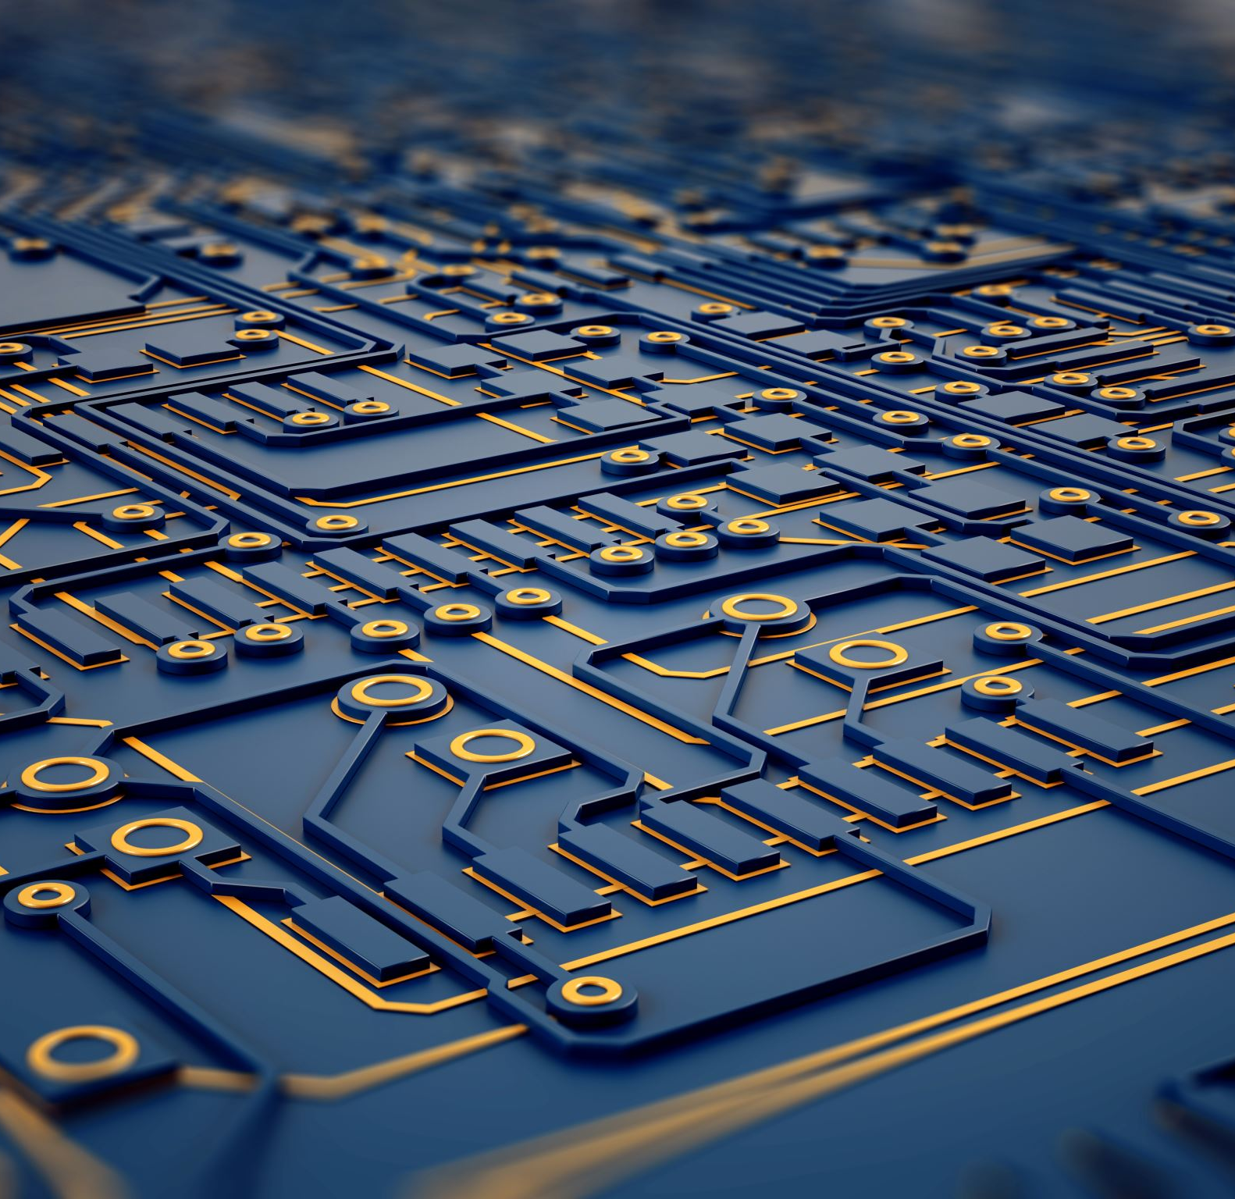
Today’s topics
Sensor Communications: (Wireless edition)

Slide 6
Think, pair, share
Think (3 mins): list out as many wireless Data transfer technologies as you can think of
Pair (3 mins): pair up with one other person and discuss
Share (5 mins): share your thoughts with the class

Slide 7
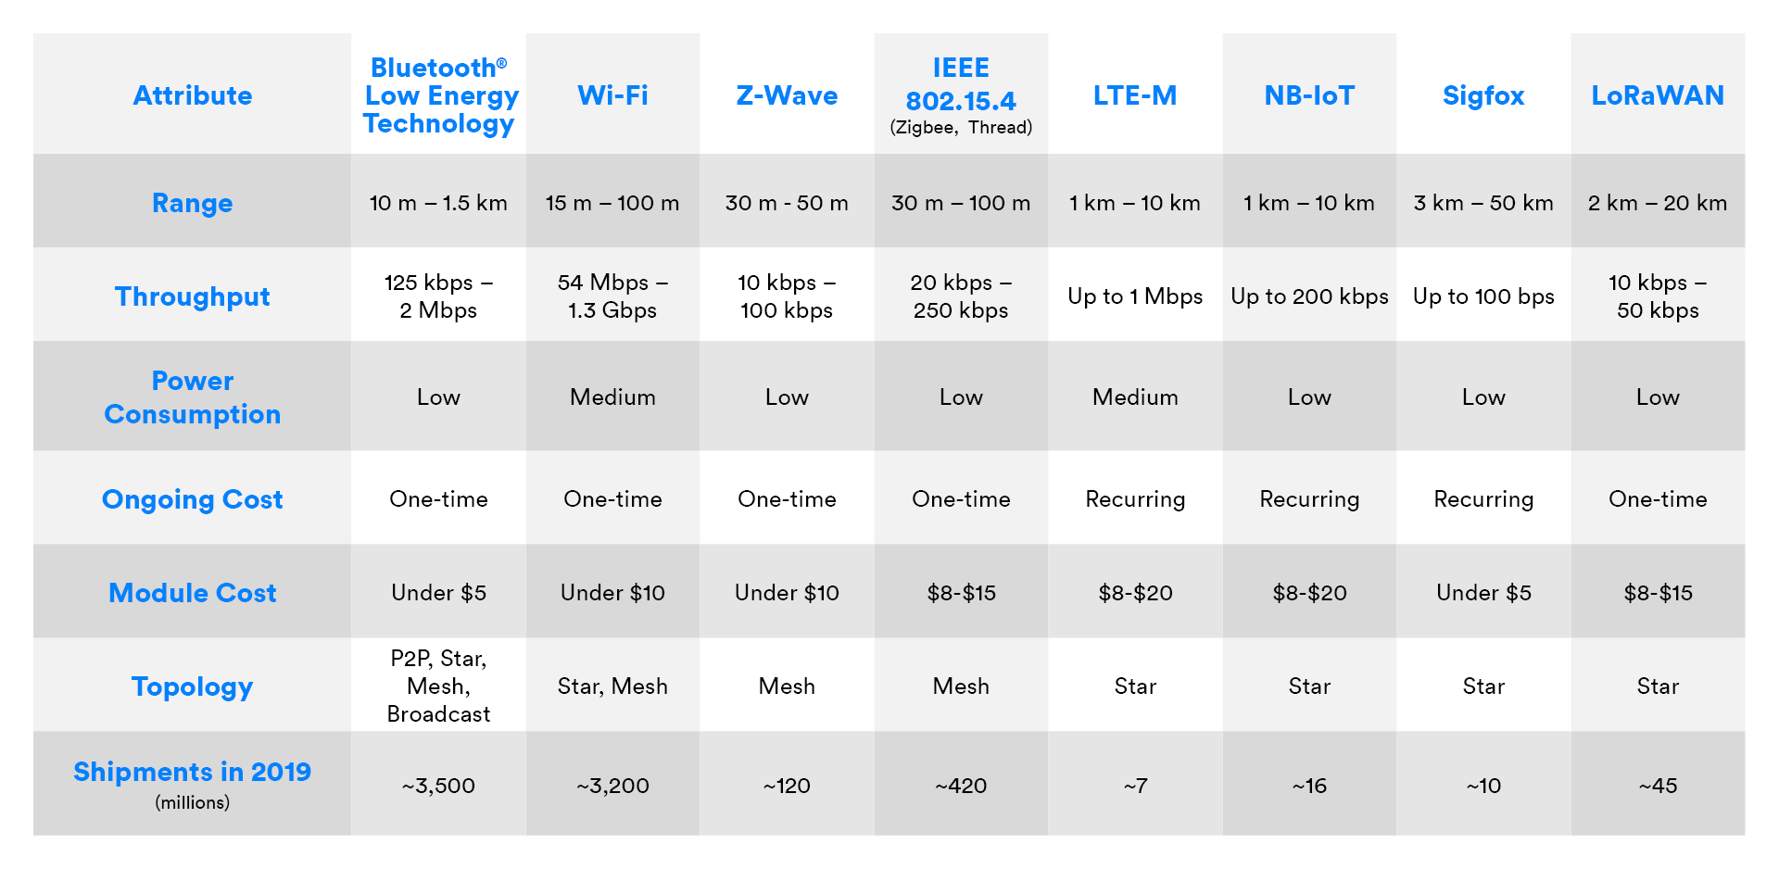
Comparison
https://www.bluetooth.com/blog/wireless-connectivity-options-for-iot-applications/

Slide 8
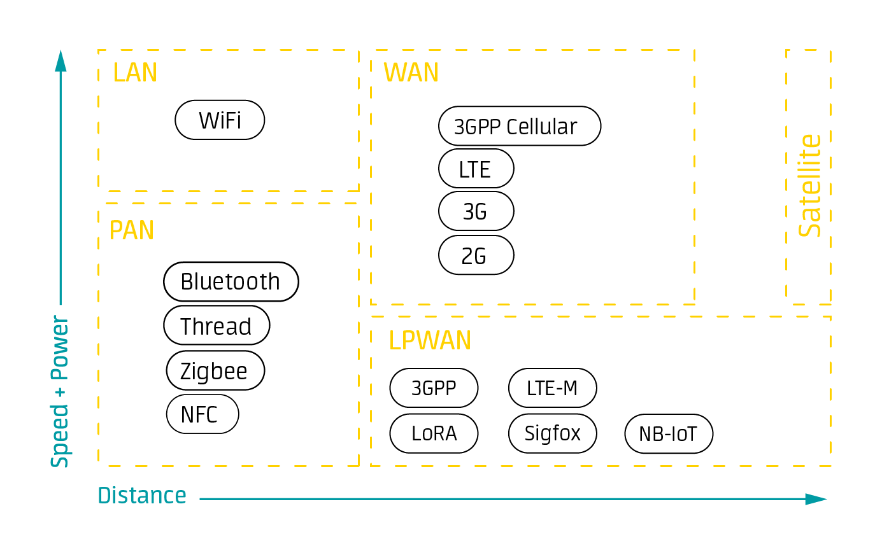
https://www.avsystem.com/blog/iot-connectivity/

Slide 9

Summary: what’s the best option? It depends…
Satellite: global coverage, more power, more $
Cellular: distributed but not truly global coverage, medium power, medium $
BLE: requires a mobile device with an app, very low power, low $
WiFi: requires a WiFi network, low power, low $
Others: typically not sufficiently available for global deployments, but can work for local needs

Slide 10
Assignment (due Sep. 29) 1 per group
Short presentation on your instrument
~5 minutes, just a couple slides
Most critical: methods/principles of operation—how does it work?!
Methods: how is it built, what does it do?
Principles of operation: how does it convert some physical (chemical, biological) quantity (e.g., conductivity) to a voltage (e.g., it transmits a voltage across the water and measures current flow, enabling the calculation of resistance and therefore conductance)?
What accuracy, precision, stability, and response time can we expect?

Slide 11
Order (alphabetical by team name, this time only)
Team Chlorophyll
Team Turbidity
Team Water Level
Team Water Quality

Slide 12
Chlorophyll a Fluorometer
By: Mia Carulli, James Lockwood and Jessie Wynne

Slide 13
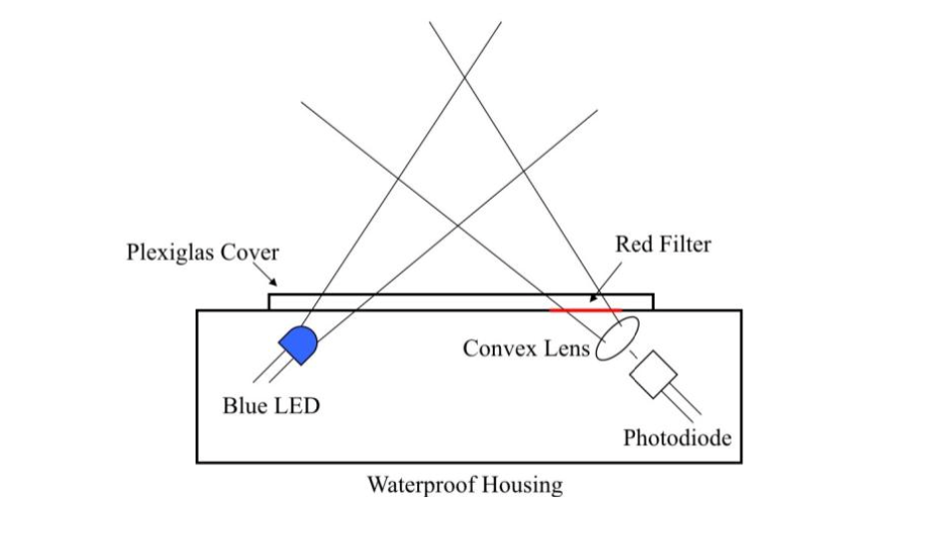
How is it built?
Waterproof box with a plexiglass window
Excitation light source
Detector
Transimpedance amplifier
Arduino Duemilanove microcontroller
SD Card
Calibration

Slide 14
Accuracy, precision, and response time
Two 9v batteries provide power for 24 hours
LED light needs 1.5 minutes to warm up
- allows the LED to stabilize
- saves battery
Sampling interval of 10 minutes
Accuracy of sample depends on turbidity
Ambient light can also affect data collection
- opaque tube can be used to create a flow through sensor
Error of sensor measurement compared to commercial device +/- 4%

Slide 15
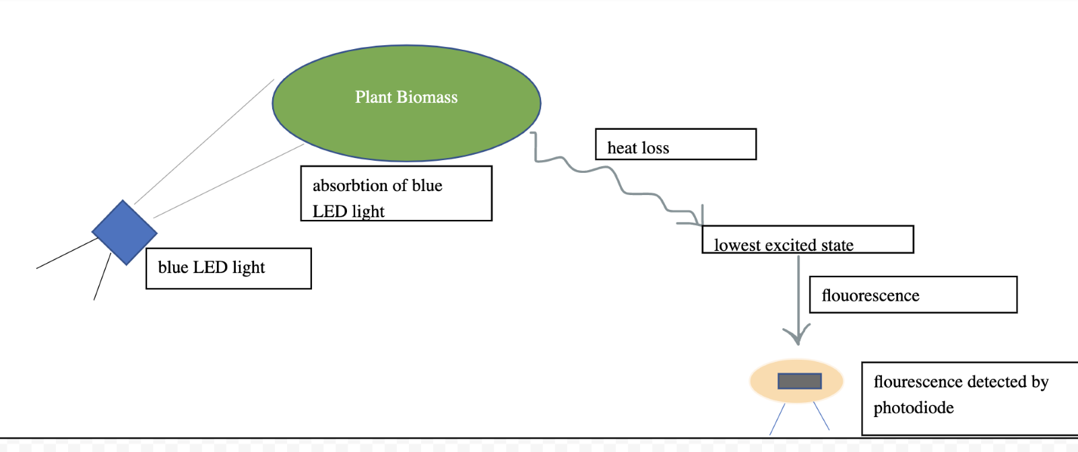
Chlorophyll Fluorescence
Light absorbed by the chlorophyll molecules causes an increase in energy state, when the molecules return to their lower state they fluoresce.
Measured in ppm

Slide 16
Citations
Maxwell, K., & Johnson, G. N. (2000). Chlorophyll fluorescence—a practical guide. Journal of Experimental Botany, 51(345), 659–668. https://doi.org/10.1093/jexbot/51.345.659
Leeuw T, Boss ES, Wright DL. In situ Measurements of Phytoplankton Fluorescence Using Low Cost Electronics. Sensors. 2013; 13(6):7872-7883. https://doi.org/10.3390/s130607872

Slide 17
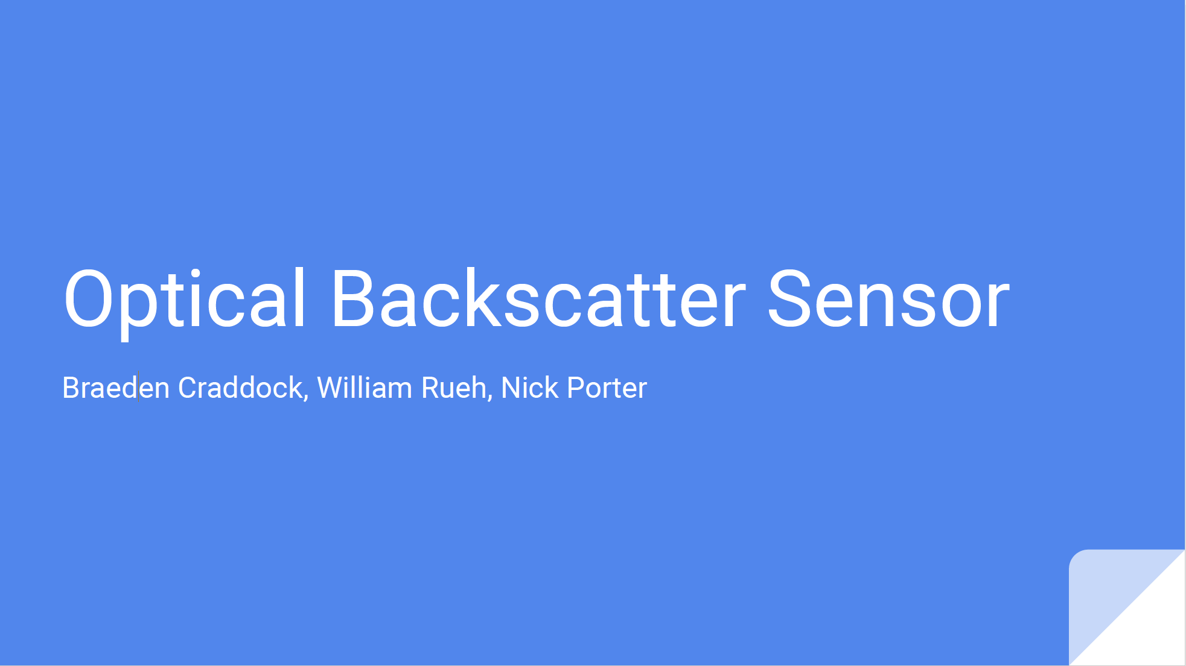

Slide 18
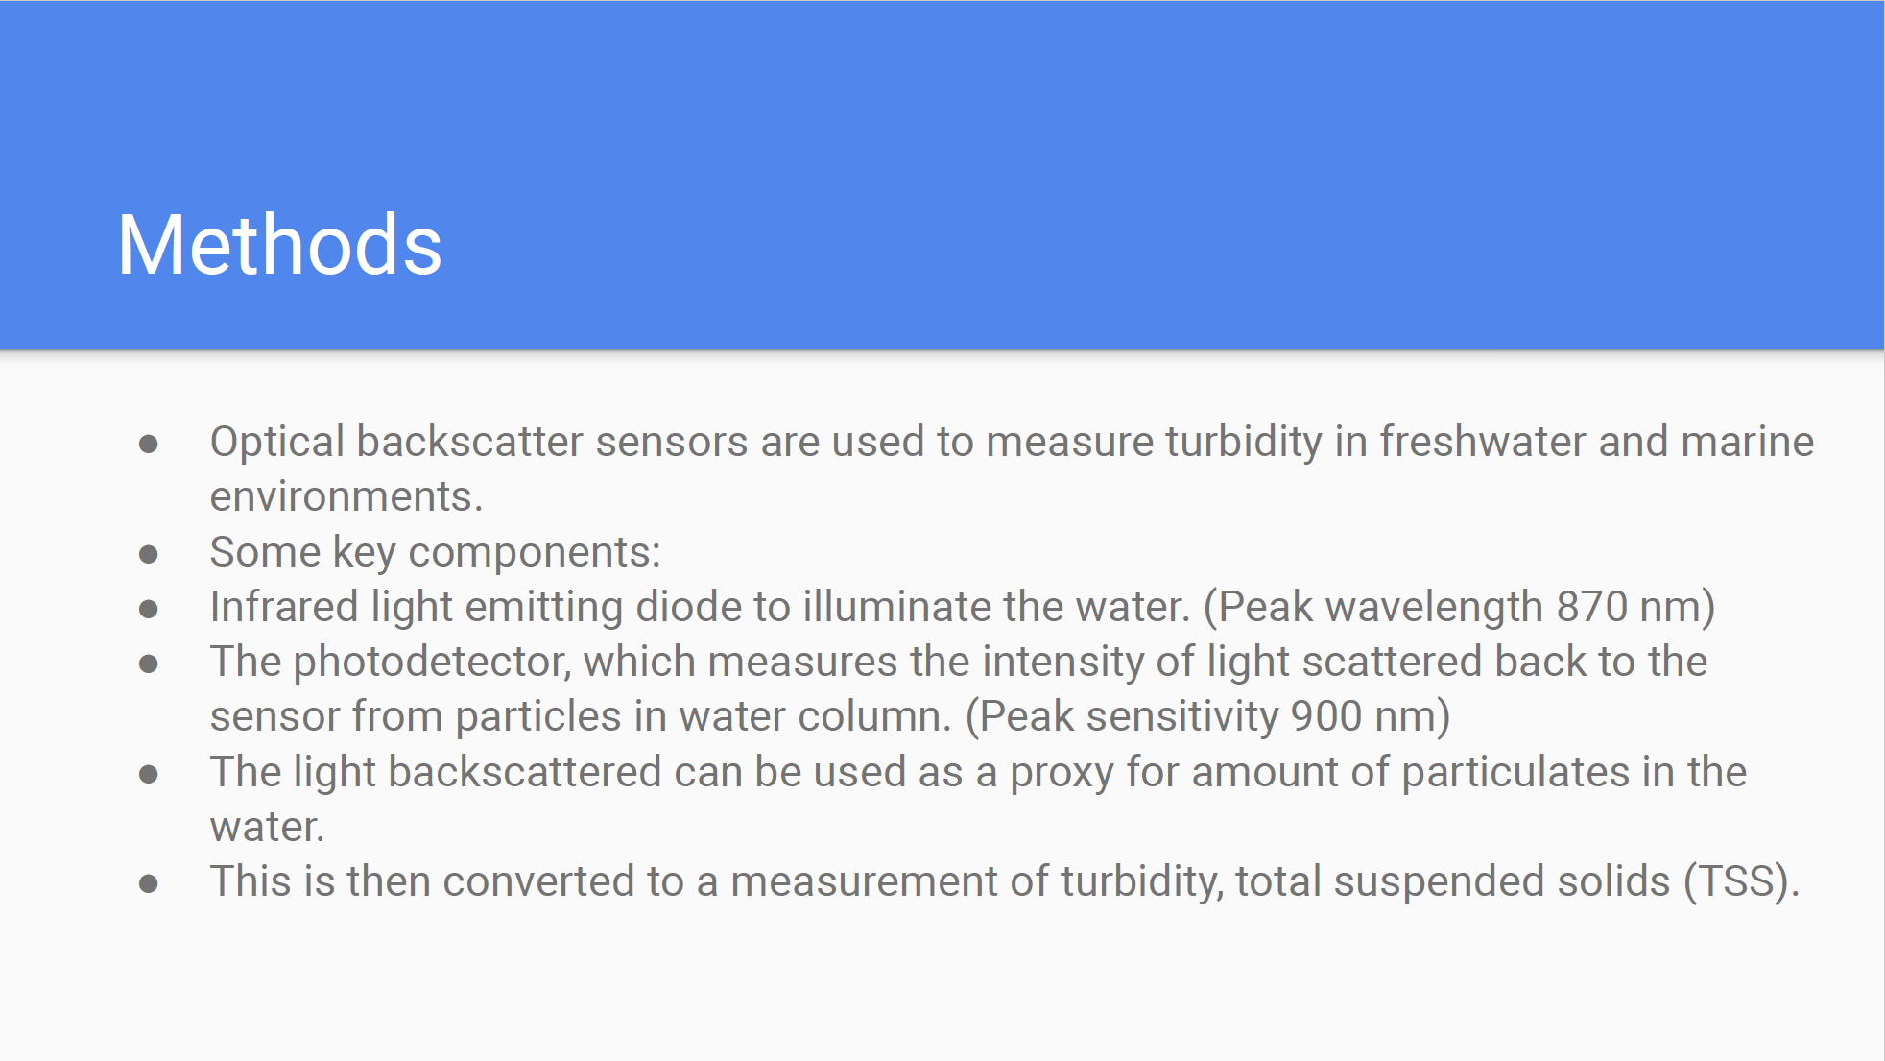

Slide 19
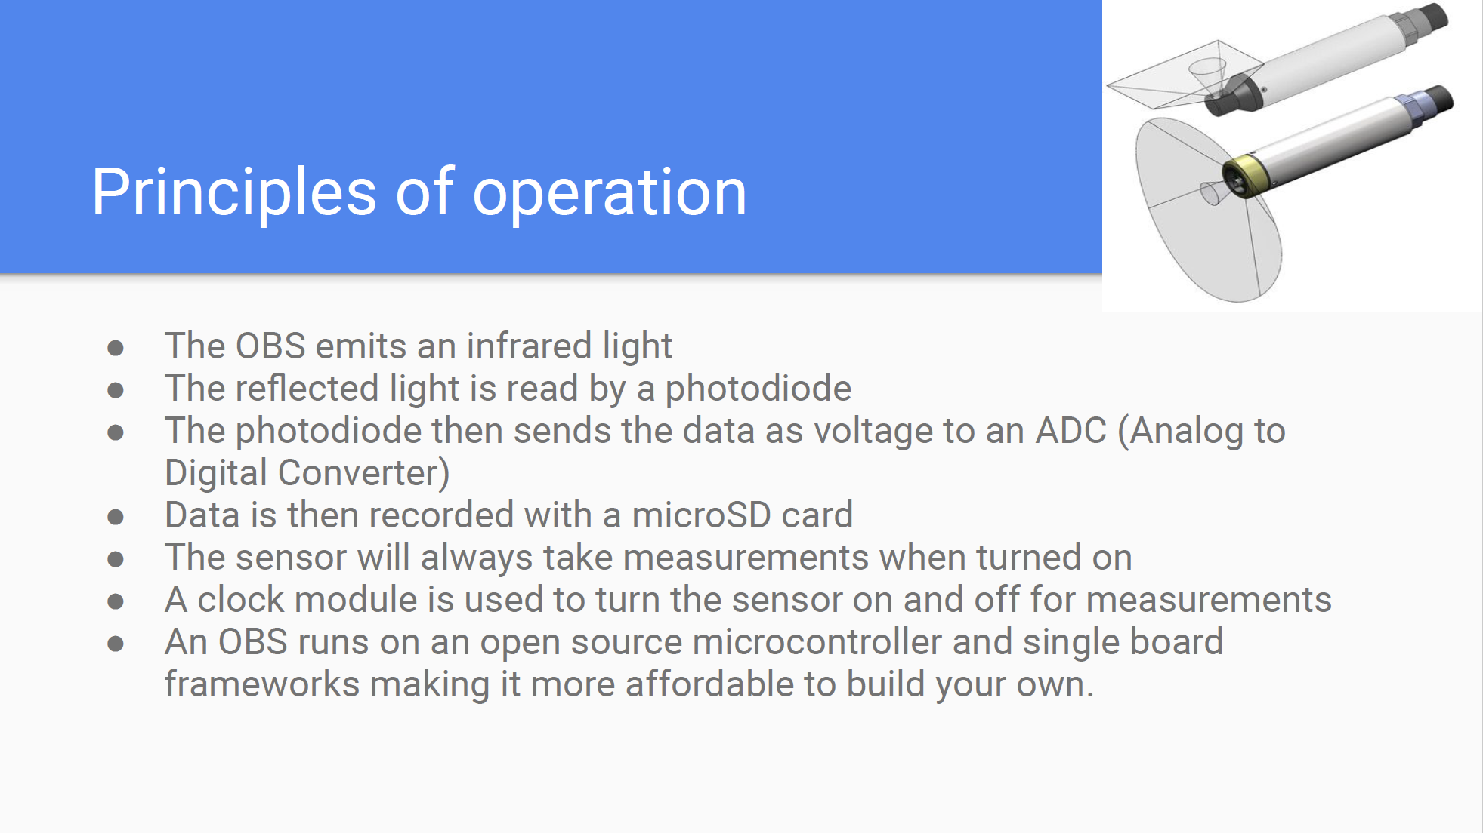

Slide 20
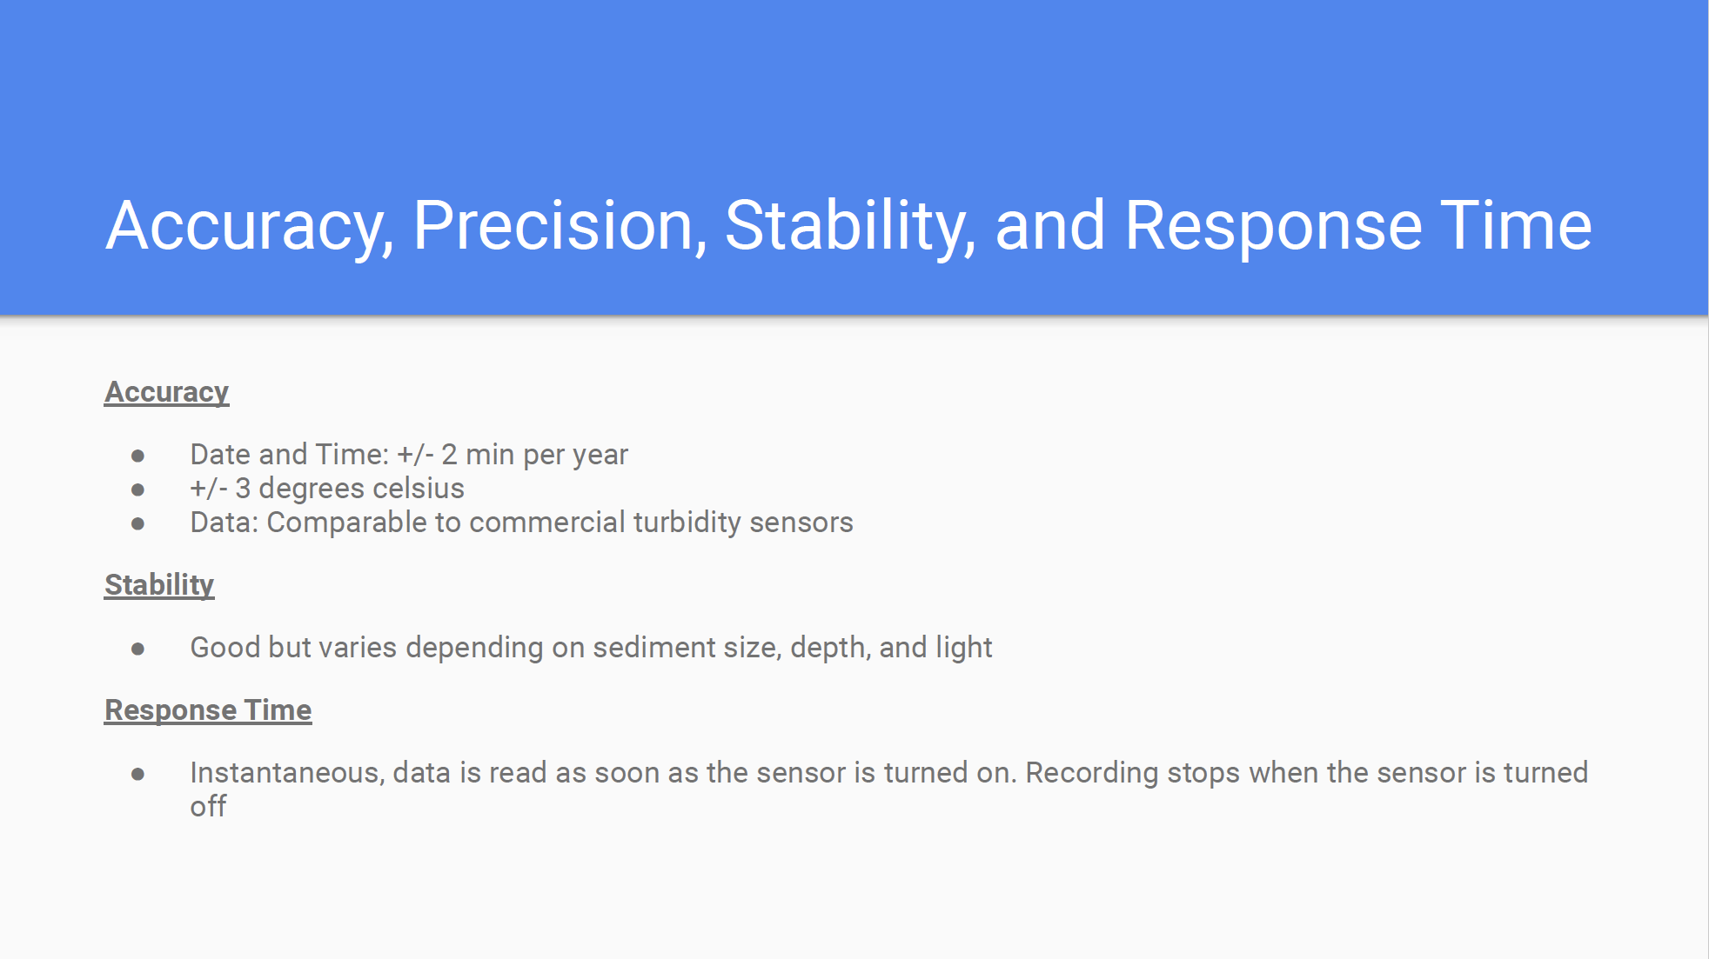

Slide 21
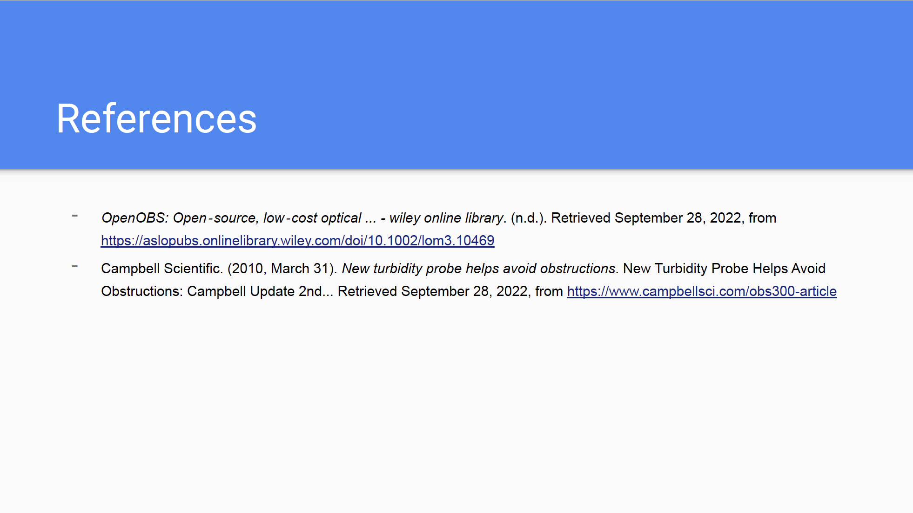

Slide 22
Low-Cost Water Level Sensor
Ashley Holsclaw, Matt Larson, & Summer Banning
OCN 479 – Smart Coasts

Slide 23
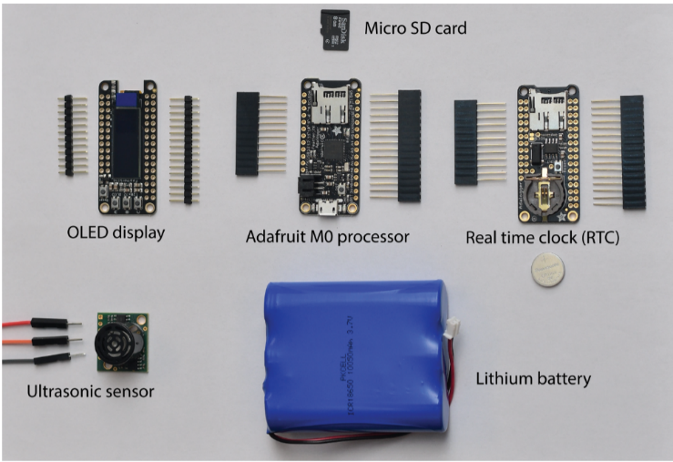
Methods
Water level sensor – measures the elevation of water relative to some known datum (e.g., NAVD88, MSL)
Components:
Microcontroller/Data Logger
Adafruit Adalogger or Particle Boron
Maxbotix LV-EZ4 ultrasonic rangefinder
Adafruit FeatherWing OLED screen
Adafruit FeatherWing Real-Time Clock
Rechargeable lithium-ion battery
Enclosure
Upcycled plastic or custom design
Source: Bresnahan et al., 2022

Slide 24
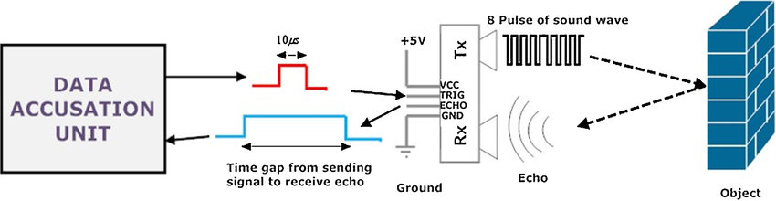
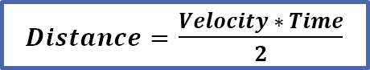
Principles of Operation
Ultrasonic sensor emits high frequency sound waves that reflect off water
Sensor measures the time it takes for the sound wave to travel to the water surface and reflect back
Time is converted to distance
Velocity = speed of sound = 343 m/s
Analog to digital converter (ADC)
Analog output → digital counts → physical distances
$Distance=$ $\frac{Velocity ∗ Time}{2}$
Source: Panda et al., 2016

Slide 25
Specifications
Accuracy: 5 cm
Range: 15 – 645 cm
Resolution: 2.5 cm
Response Time: 1 / (speed of sound * distance * 2) s
Required voltage: 3.3 V
Max sampling frequency: 20 Hz
Output frequency: 42 kHz

Slide 26
Water Quality Testing Device
Mitch, Grace, Jack

Slide 27
Principles of Operation? How does it measure it?
Temperature: uses resistance and the Steinhart equation to map a temperature curve (can be digital or analog) as temperature increases, resistance drops.
Conductivity: measures salinity based on the electrical current from the major ions of seawater, by applying an alternating electrical current between two electrodes
pH: measures based on the level of free Hydrogen ions [H+]; with an increase in the concentration of [H+] there is a decrease in pH.
A KCl solution is used and based on the testing solutions reaction to that KCl and the movement of protons, a current is created which is then relayed to the microchip and analyzed with the Nernst equation
Dissolved Oxygen: measures the amount of oxygen that passes through the semipermeable membrane, and then gets reduced to OH, the sensor measures the amount of reduction taking place from an electrical current. This current is fed back to the microchip to measure it in a percentage.

Slide 28


Data Flow
Sensor Array
Particle Boron
pH
Cond.
Array Components:
Particle Borons microcontroller
GPS Featherwing add-on
Adalogger Featherwing RTC + microSD card
Atlas Scientific Tentacle T3 Shield
Whitebox T2 Mini MKII
[DO EZO + Atlas Scientific Probe] for measuring Dissolved Oxygen
[EC EZO + Atlas Scientific Probe] for measuring conductivity
[RTD EZO + Atlas Scientific Probe] for measuring temperature
[pH EZO + Atlas Scientific Probe] for measuring pH
[Device] for measuring depth (echosounder, pressure) (YSI EXO2)
Temp.
DO
Depth
Notes:
This is the data flow chart of our sensor. The probes are placed in the water to collect a sample, data is sent through the sensor array, which comprised of the microcontroller (Particle Boron), Battery, SD card, power isolation circuit (Tentacle T3 Shield), and individual controllers for each probe. The particle boron is 4G and able to send data to the cloud which is inputted directly into a google sheet.

Slide 29
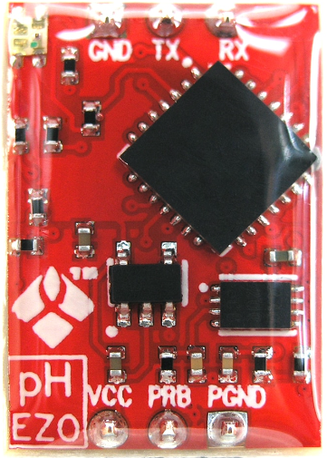
Accuracy, Precision, Stability, and Response Time
DO EZO - Accuracy: +/- 0.05 mg/L ; Response Time: 1 reading per second
EC EZO - Accuracy: +/- 2%; Response Time: 1 reading per second
RTD EZO - Accuracy: +/– (0.1 + 0.0017 x ˚C); Response Time: 1 reading per second
pH EZO - Accuracy: +/– 0.002; Response Time: 1 reading per second
GPS Featherwing - Accuracy: Position = 1.8 meters, Velocity = 0.1 meters/s; Response Time: 10 Hz updates Stability: -165 dBm sensitivity
All EZO devices have high accuracy and stability
They also have high precision, except when electrical noise is interfering with the readings it is common to see rapidly fluctuating readings or readings that are consistently off
EZO™ pH Circuit | Atlas Scientific (atlas-scientific.com)

Slide 30
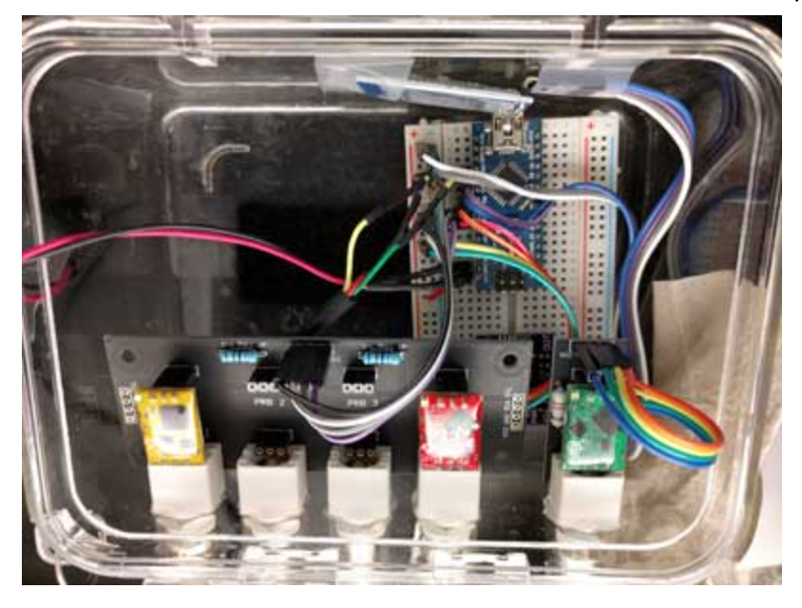
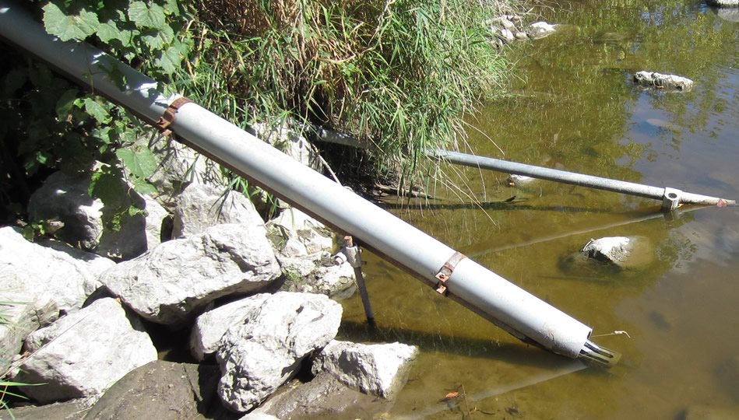
Housing Design
PVC piping with o-ring/silicone sealants
Pelican case
https://acwi.gov/methods/sensors/field_deploy/index.html

Slide 31
Work Cited
DO_EZO_Datasheet.pdf (atlas-scientific.com)
EC_EZO_Datasheet.pdf (atlas-scientific.com)
EZO_RTD_Datasheet.pdf (atlas-scientific.com)
pH_EZO_Datasheet.pdf (atlas-scientific.com)
Overview | Adafruit Ultimate GPS featherwing | Adafruit Learning System
https://www.ysi.com/ysi-blog/water-blogged-blog/2019/02/anatomy-of-ph-electrodes
https://group.chem.iastate.edu/Holme/augmented-reality-in-educational-laboratories/conductivity/
https://atlas-scientific.com/blog/how-do-dissolved-oxygen-probes-work/#:~:text=Dissolved%20oxygen%20probes%20work%20by,is%20displayed%20on%20a%20meter.
https://atlas-scientific.com/blog/how-do-temperature-sensors-work/#:~:text=Temperature%20sensors%20work%20by%20providing,increases%2C%20the%20temperature%20also%20increases.
https://oceanographyforeveryone.com/project/openctd/
https://github.com/IanTBlack/CTDizzle
https://theoryandpractice.citizenscienceassociation.org/articles/10.5334/cstp.124/

